Slide 1
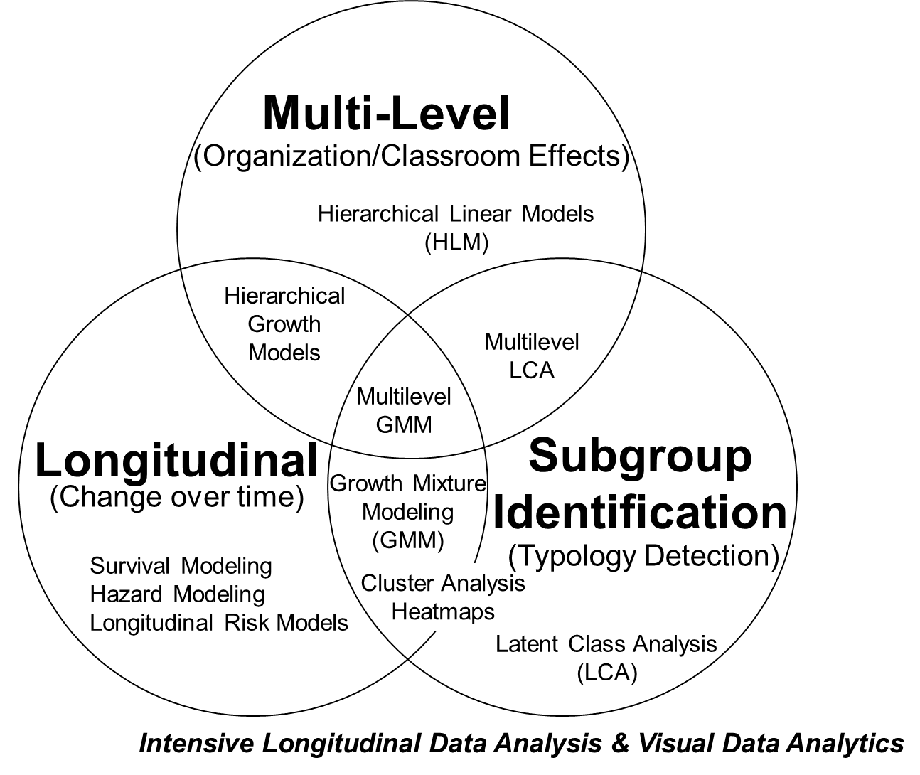
ORLA 6641: Advanced Topics in Research Methods and Design
April 13, 2020
Today: Latent Class Analysis (LCA)
Meg Duff
LCA and NYC schools
Bowers & Sprott (2012)
Boyce & Bowers (2016)
Graves & Bowers (2017)
Vaval et al. (2019)
Lanza & Rhoades (2013)
Next week:
LCA focus group
Two weeks:
Tufte and how to present clear and honest studies
Three & Four weeks:
Final presentations

Slide 2
Final Presentations
May 4:
May 11:
Aidi
Yi
Rachel
Jingru
Zhongyuan
Alex
Soojin
Aki
Sarah
Leo
Lesheng
See Canvas for Assignment, presentation details, and Exemplars
10-12 minute presentation (please practice)
2 minutes from class (1 -2 questions)
3 minutes from Bowers (1-2 questions)

Slide 4
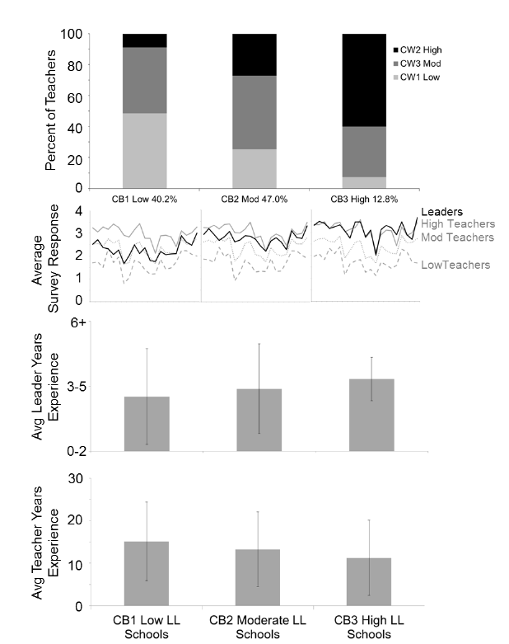
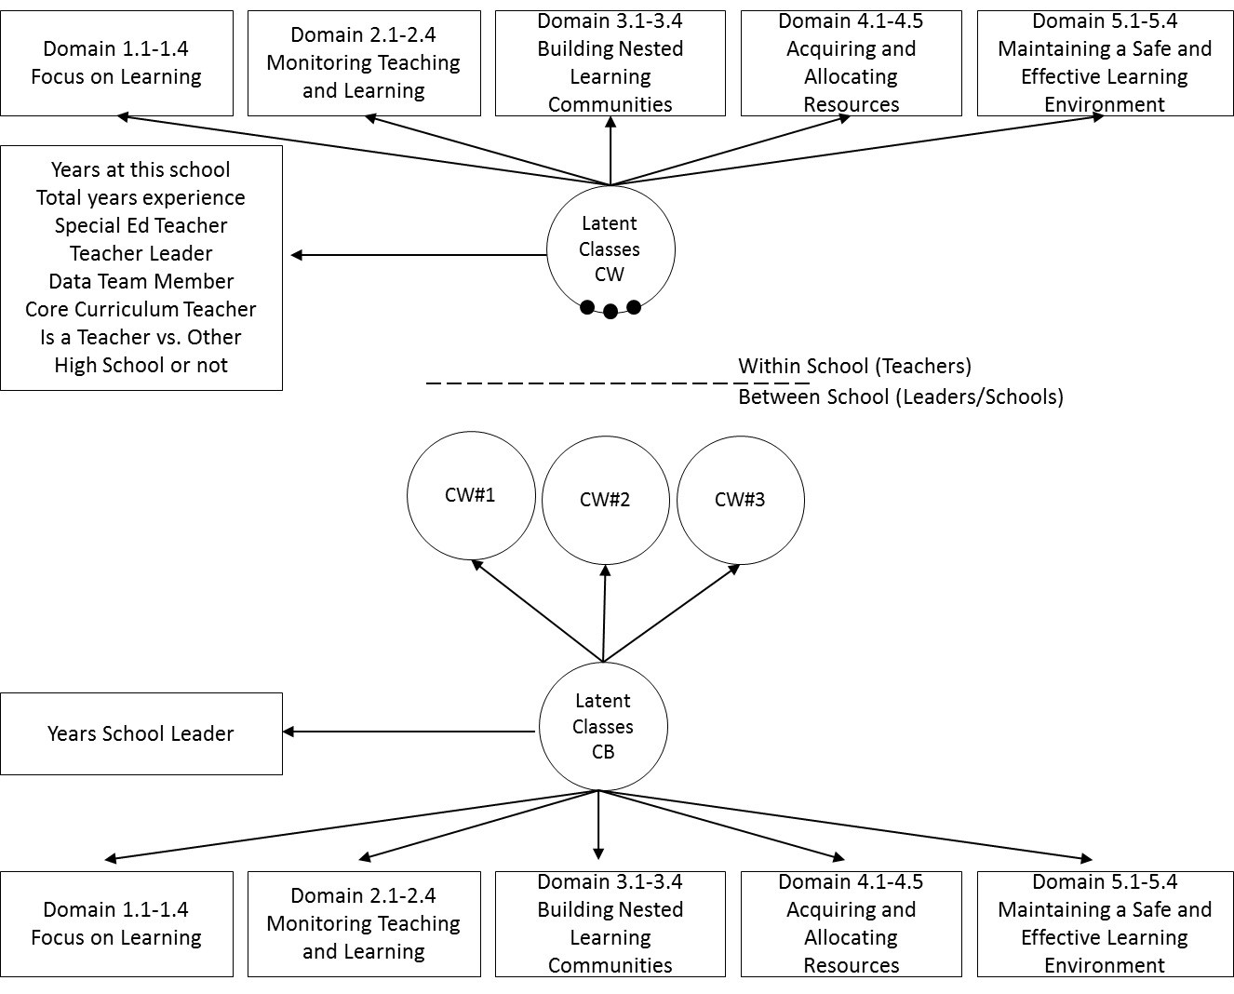
Bowers, A.J., Blitz, M., Modeste, M., Salisbury, J., Halverson, R. (2017) Is There a Typology of Teacher and Leader Responders to CALL, and Do They Cluster in Different Types of Schools? A Two-Level Latent Class Analysis of CALL Survey Data. Teachers College Record, 119(4) http://www.tcrecord.org/Content.asp?ContentId=21677
Open Access: https://doi.org/10.7916/d8-dwbk-mt40

Slide 5
Why 10th Graders Drop Out of High School: A Latent Class Analysis of a Dropout Typology
Alex J. Bowers
Ryan Sprott

Slide 6
Background & Purpose
Dropping out of school has historically been viewed as a single monolithic category
Emerging research indicates that there are multiple different “types” of dropouts*
However, much of the past research has been based on qualitatively derived categories, or non-inferential statistics, such as cluster analysis.
The purpose of this study is to examine the different typologies of high school dropouts from a large nationally representative sample using latent class analysis (LCA)
* Bowers (2010), Janosz et al. (2000), Kronick & Hargis (1989), Lessard et al. (2008), Fortin et al. (2006), Menzer & Hampel (2009)
Alex Bowers, (2011) AERA

Slide 7
Overview of past dropout typology categories

Slide 8
Research Questions
How many dropout typologies are significantly different from each other?
What are the specific characteristics that identify the different typologies of dropouts?
After dropping out, what do students report are the reasons that they dropped out two years later, and to what extent are these reasons associated with the different typologies?

Slide 9
Sample & Method
Sample: Education Longitudinal Survey of 2002 (ELS:2002)
Survey of about 15,400 students in grade 10 in 2002 across about 750 high schools
Sample: n=1,470 students with evidence of a dropout episode prior to high school graduation.
Method: Latent Class Analysis (LCA)
LCA using multi-nomial logistic regression within a structural equation mixture model (SEM)
LCA identifies the extent to which a distribution of survey responses fit to one distribution or multiple distributions (typologies)

Slide 10
Latent Class Analysis Model for Dropout Typologies

Slide 11
Latent class analysis (LCA) results and fit indices

Slide 12
Responses of Three Typologies of Dropouts to Dichotomously Scaled Survey Items

Slide 13
Distributions of Continuous Variables from the LCA Typologies

Slide 14
Distributions of Continuous Variables from the LCA Typologies

Slide 15
Percent responses to survey questions in 2006 about why the student dropped out of school, disaggregated by typology
Significant tests are Pearson chi-square: *p ≤ 0.05, **p ≤ 0.01, ***p ≤ 0.001

Slide 16
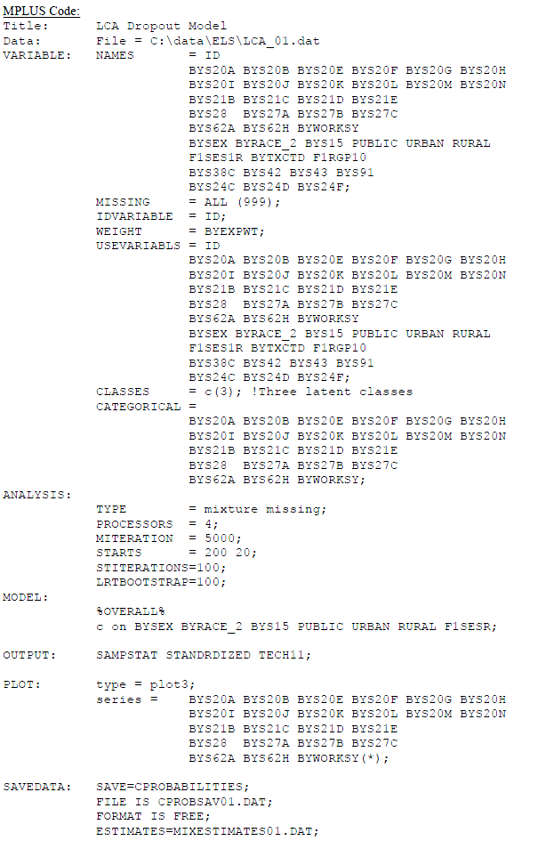

Slide 17
Conclusions & Future Work
Conclusions:
Identified three statistically significantly different dropout typologies: Quiet, Jaded, Involved
Latent Class Analysis provides a rich description of the different typologies of student responses before they dropped out
The 2006 follow-up survey validates the typology model
Use of LCA with a nationally representative sample allowed us to appropriately model the student survey responses and identify three typologies as the best model fit, controlling for background variables
Recommendations: Different dropout intervention strategies could be devised for the different type of student who drops out.
Future work
Replicate using other datasets and contexts
Qualitative analysis of the different typologies

Slide 18


Are there different types of principals who exit their jobs?
Boyce, J., Bowers, A.J. (2016) Principal turnover: Are there different types of principals who move from or leave their schools? A Latent Class Analysis of the 2007-08 Schools and Staffing Survey and the 2008-09 Principal Follow-up Survey. Leadership and Policy in Schools, 15 (3), p. 237-272. http://dx.doi.org/10.1080/15700763.2015.1047033
Jared Boyce

Slide 19
Rates of Principal Turnover
In 2008-09, 18% of principals exited their schools (“movers” and “leavers” combined)
Battle & Gruber, 2010
Principal turnover rates are increasing
DeAngelis & White, 2011
Some schools have had five principals in a ten-year period of time
Weinstein, Jacobowitz, Ely, Landon & Schwartz, 2009
Supply and demand issues around hiring new principals
DeAngelis & O’Connor, 2012

Slide 20
Costs of Principal Turnover
Negative impact on student achievement
Béteille, Kalogrides & Loeb, 2012; Miller, 2013
Increase in teacher turnover
Fuller, Young & Orr, 2007; Kearny, Valdez & Garcia, 2012
Negative impact on school climate
Fauske & Ogawa, 1987; Leithwood, Harris & Hopkins, 2008
High resource costs
School Leaders Network, 2014
Schools with low-achieving, high-minority, low-SES students have higher principal turnover and larger negative impacts
Branch, Hanushek & Rivkin, 2012; Loeb, Kalogrides & Horng, 2010

Slide 21
Factors Predicting Principal Turnover
Principal factors: gender, age, race/ethnicity, teaching experience, principal experience, leadership practices, influence, education
School factors: school size, student demographics, student SES, grade levels, school type, student achievement, urbanicity
Climate factors: positive relationships with teachers, school orderliness, student disrespect for teachers, parent participation
Akiba & Reichardt, 2004; Battle & Gruber, 2010; Cullen & Mazzeo, 2008; Davis, 1998; DeAngelis & Young, 2011; Lovely, 2004; Papa Jr., 2007; Partlow & Ridenour, 2008; Sheppard, 2010

Slide 22
Conceptual Framework
Quantitative research and most qualitative research into principal turnover has consistently treated exiting principals as a single group.
Some qualitative research suggests that there are (at least) two groups of principals who exit their schools.
Johnson (2005): satisfied vs. unsatisfied exiters
Farley-Ripple, Raffel & Welch (2012): some principals are pulled out vs. some principals are pushed out

Slide 23
Methods and Sample
2007-08 Schools and Staffing Survey (SASS)
National Center for Education Statistics (NCES)
Seven administrations: 87-88, 90-91, 93-94, 99-00, 03-04, 07-08, 11-12
Generalizable at state and national levels
2008-09 Principal Follow-up Survey (PFS)
Companion instrument to SASS
Measures principal turnover behaviors, not intent

Slide 24
Methods and Sample
Latent Class Analysis (LCA)
Jung & Wickrama, 2008; Masyn, 2003; Muthén, 2002, 2004; Muthén & Asparouhov, 2002, 2008; Samuelsen & Raczynski, 2013
LCA looks at a set of “indicator variables” and calculates the extent to which the data are better explained by k-1 classes (subgroups) in the sample or by k classes in the sample.

Slide 25
Methods and Sample
7,460 principals were in the PFS dataset
n = 1,470 who exited (<1% missing)
18 dichotomized indicator variables (0% missing)
Self-perceptions of leadership influence
Perceived frequency of school climate problems
Principal attitudes
Salary disposition

Slide 26
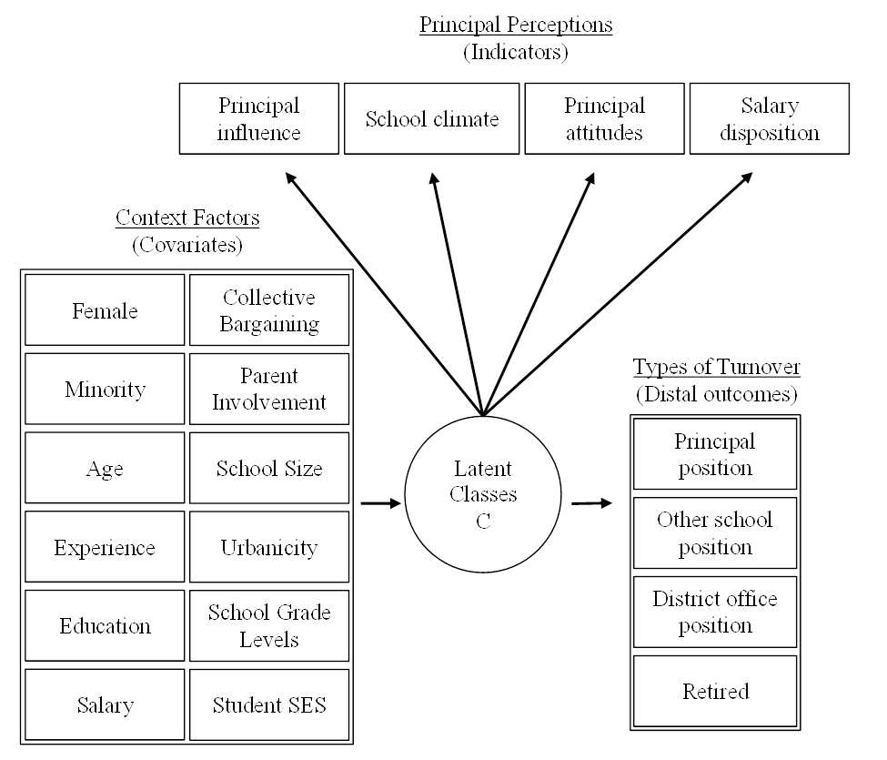
Latent Class Analysis of the 2007-08 Schools and Staffing Survey (SASS) and 2008-09 Principal Follow-up Survey (PFS)
Nationally generalizable sample of n=1,470 Principals who exited their positions

Slide 27
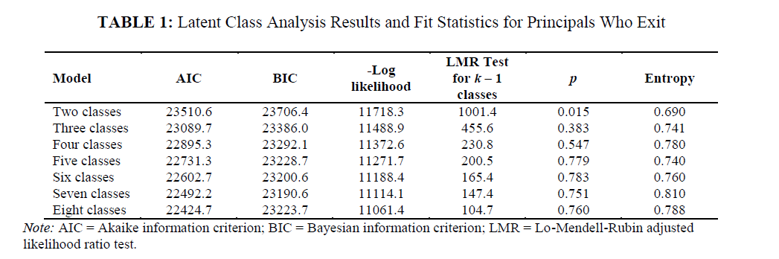

Slide 28
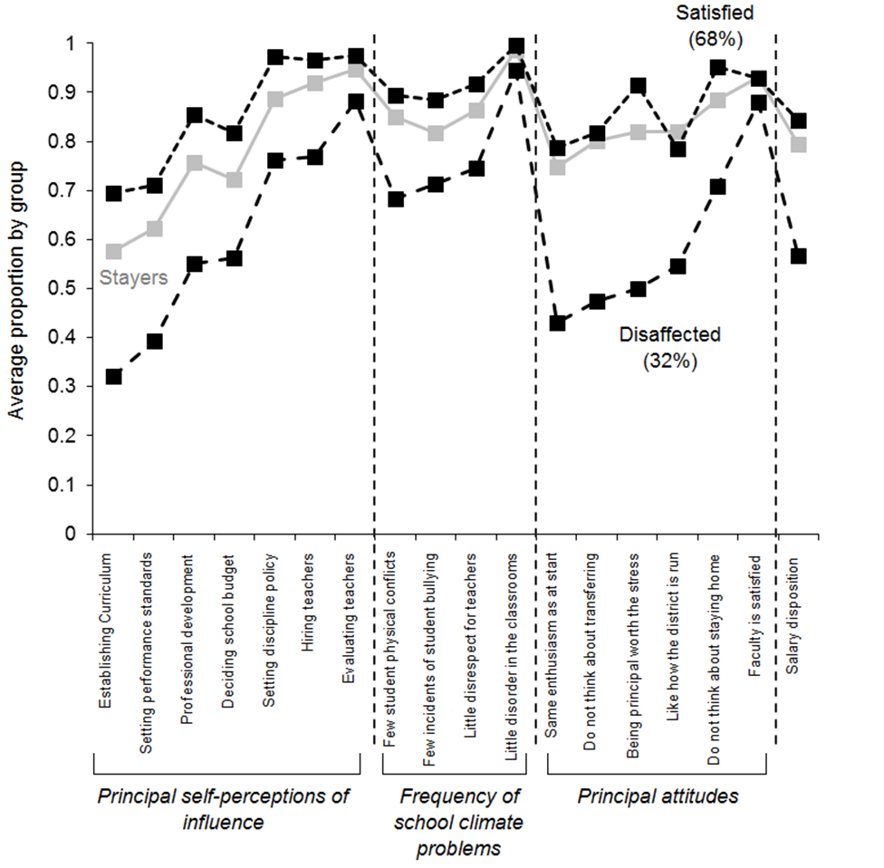
Latent Class Analysis of the 2007-08 Schools and Staffing Survey (SASS) and 2008-09 Principal Follow-up Survey (PFS)

Slide 29
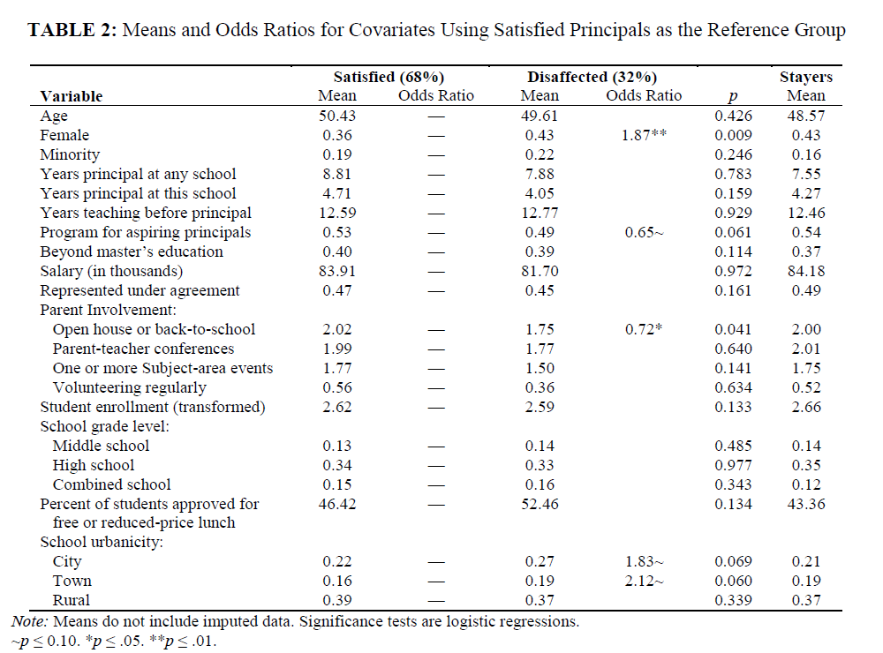

Slide 30
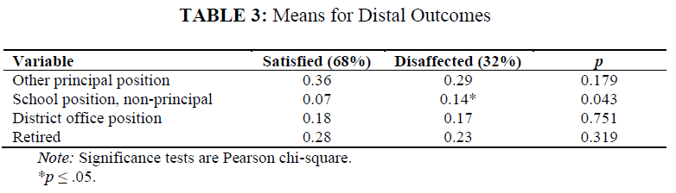

Slide 31
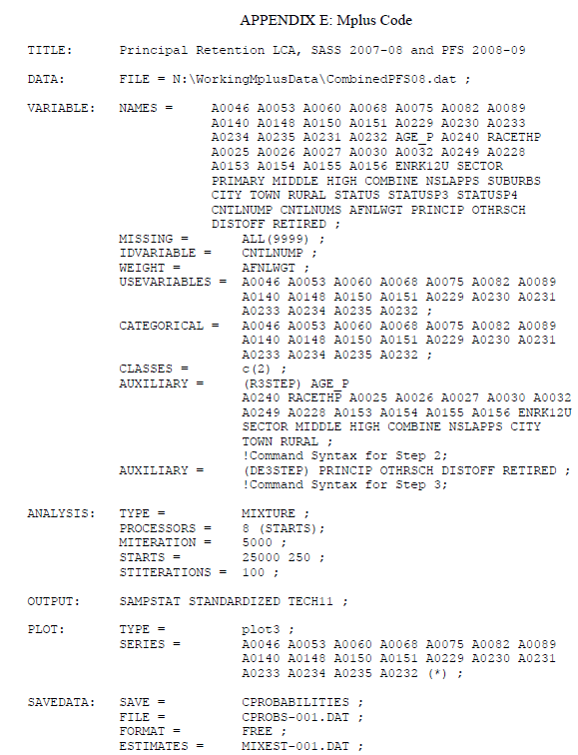

Slide 32

Toward a Typology of Technology-Using Teachers in the “New Digital Divide”: A Latent Class Analysis (LCA) of the NCES Fast Response Survey System Teachers’ Use of Educational Technology in U.S. Public Schools, 2009 (FRSS 95)
Graves, K.E., Bowers, A.J. (2018) Toward a Typology of Technology-Using Teachers in the “New Digital Divide”: A Latent Class Analysis (LCA) of the NCES Fast Response Survey System Teachers’ Use of Educational Technology in U.S. Public Schools, 2009 (FRSS 95)
Teachers College Record, 120 (8), http://www.tcrecord.org/Content.asp?ContentId=22277
Open Access Version: https://doi.org/10.7916/d8-ddmv-y558
Kenny Graves

Slide 33
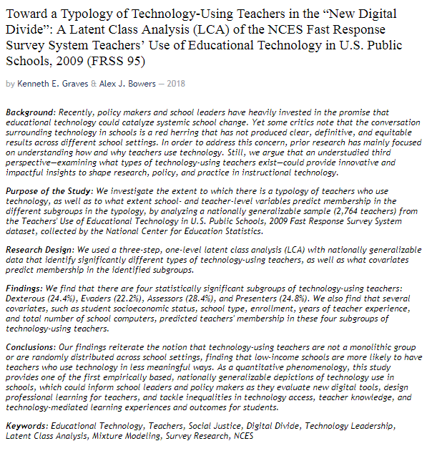

http://www.tcrecord.org/Content.asp?ContentId=22277

Slide 34
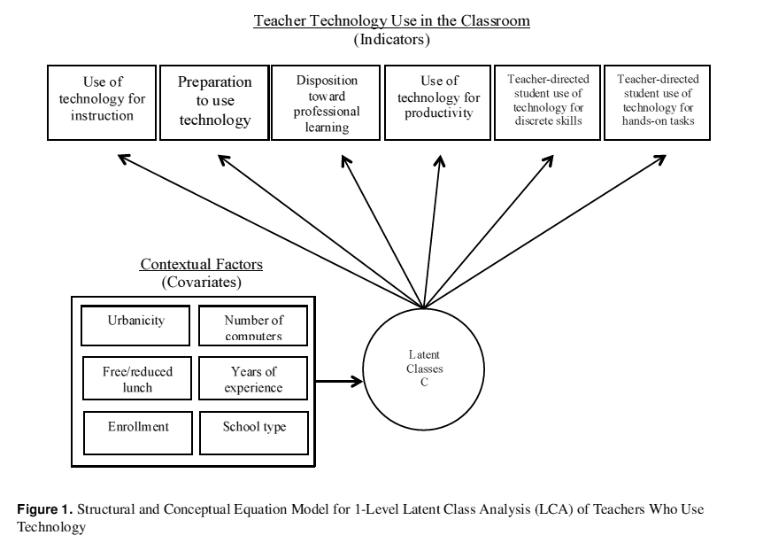

Slide 35
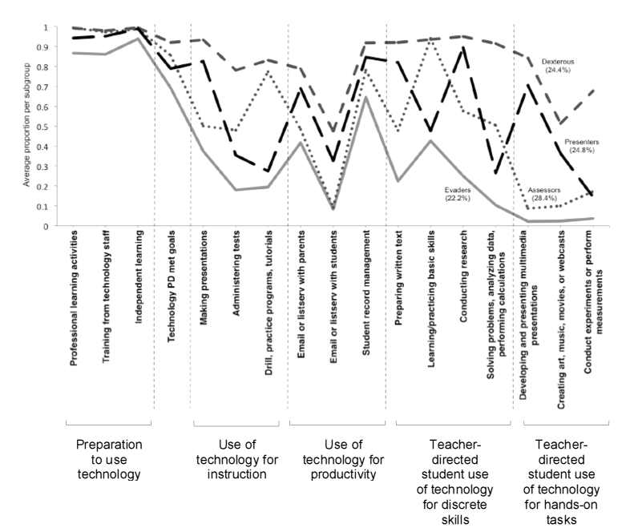

Slide 36
